Slide 1
UNIT IV
Sampling

Slide 2
Unit-IV: Sampling
Sampling and sampling distributions: Basic Concepts:
Defining the Universe, Concepts of Statistical Population, Sample, Characteristics of a good sample, Sampling errors, Non Sampling errors, Methods to reduce the errors, Sample Size constraints, Non Response.
Types of Sampling.
Determining size of the sample – Practical considerations in sampling and sample size, sample size determination.

Slide 3
Sampling
A sample is a subset of a larger population of objects individuals, households, businesses, organizations and so forth.
Sampling enables researchers to make estimates of some unknown characteristics of the population in question.
A finite group is called population whereas a non-finite (infinite) group is called universe
A census is a investigation of all the individual elements of a population
Population
Sample

Slide 4
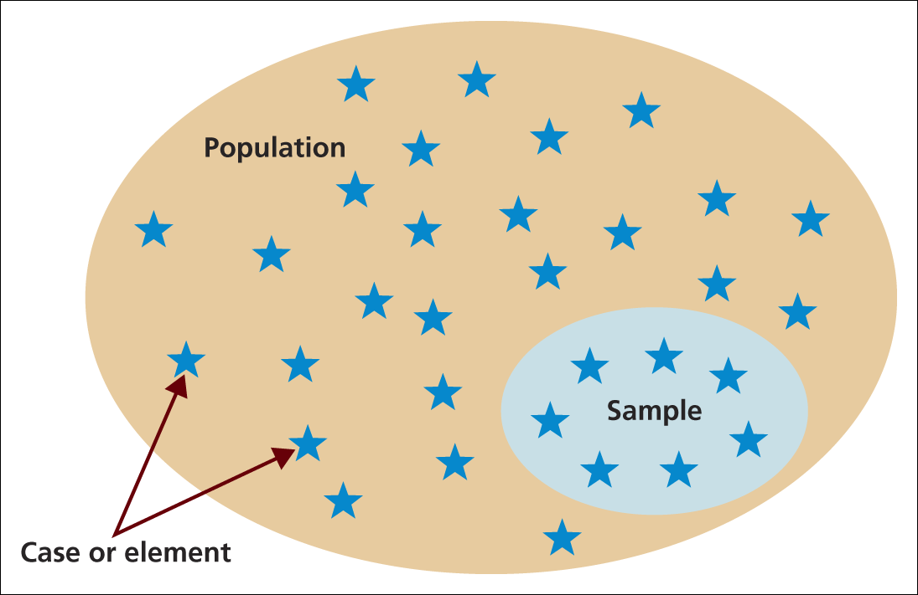
Selecting samples
Population, sample and individual cases
Source: Saunders et al. (2009)
Figure 7.1 Population, sample and individual cases

Slide 5
Population, sample and individual cases
The basic idea of sampling is that by selecting some of the elements in a population, we may draw conclusions about the entire population.
A population element is the individual participant or object on which the measurement is taken. It is the unit of study. It may be a person but it could also be any object of interest.
A population is the total collection of elements about which we wish to make some inferences.
A census is a count of all the elements in a population.
A sample frame is the listing of all population elements from which the sample will be drawn.

Slide 6
Reasons for Sampling
Budget and time Constraints (in case of large populations)
High degree of accuracy and reliability (if sample is representative of population)
Sampling may sometimes produce more accurate results than taking a census as in the latter, there are more risks for making interviewer and other errors due to the high volume of persons contacted and the number of census takers, some of whom may not be well-trained
Industrial production and import / export

Slide 7
Why Sample?
Availability of elements
Lower cost
Sampling
provides
Greater speed
Greater accuracy
Notes:
This slide lists the reasons researchers use a sample rather than a census.

Slide 8
The need to sample
Sampling- a valid alternative to a census when
A survey of the entire population is impracticable
Budget constraints restrict data collection
Time constraints restrict data collection
Results from data collection are needed quickly

Slide 9

What Is a Valid Sample?
Accurate
Precise

Slide 10
What Is a Valid Sample?
The ultimate test of a sample design is how well it represents the characteristics of the population it purports to represent. In measurement terms, the sample must be valid.
Validity of a sample depends on two considerations: accuracy and precision.
Accuracy is the degree to which bias is absent from the sample. When the sample is drawn properly.
Precision of estimate is the second criterion of a good sample design.
Precision is measured by the standard error of estimate, a type of standard deviation measurement. The smaller the standard error of the estimate, the higher is the precision of the sample.

Slide 11
The Sampling Process
Plan procedure for
selecting sampling units
4
Determine if a probability
or non-probability sampling
method will be chosen
Determine sample size
3
5
Select a
Sampling Frame
Select actual sampling units
2
6
Define the Target
population
Conduct fieldwork
1
7

Slide 12
Defining the Target Population
The target population is that complete group whose relevant characteristics are to be determined through the sampling
A target population may be, for example, all faculty members in the Department of Management Sciences in the NIRF/AIMA network, all housewives in Rourkela, all engineering students in Rourkela, and all professors in India.
The target group should be clearly delineated if possible, for example, do all pre-college students include only primary and secondary students or also students in other specialized educational institutions?

Slide 13
The Sampling Frame
The sampling frame is a list of all those population elements that will be used in the sample
Examples of sampling frames are a student telephone directory (for the student population), the list of companies on the stock exchange, the directory of medical doctors and specialists, the yellow pages (for businesses)
Often, the list does not include the entire population. The discrepancy is often a source of error associated with the selection of the sample (sampling frame error)
Information relating to sampling frames can be obtained from commercial organizations

Slide 14
Sampling Units
The sampling unit is a single element – or group of elements – subject to selection in a sample. Examples:
Every student at NITRIS whose first name begins with the letter “S”
All child passengers under 18 years of age who are traveling in a train from destination X to destination Y
All houses in different sectors of Rourkela.

Slide 15
Sampling Errors (1)
Random Sampling Error – This is defined as the “difference between the sample result and the result of a census conducted using identical procedures” and is the result of chance variation in the selection of sampling units
If samples are selected properly (for e.g. through the technique of randomization), the sample is usually deemed to be a good approximation of the population and thus capable of delivering an accurate result
Usually, the random sampling error arising from statistical fluctuation is small, but sometimes the margin of error can be significant

Slide 16
Sampling Errors (2)
Systematic (Non-Sampling) Errors – These errors result from factors such as an improper research design that causes response error or from errors committed in the execution of the research, errors in recording responses and non-responses from individuals who were not contacted or who refused to participate
Both Random sampling errors and systematic (non-sampling) errors reduce the representativeness of a sample and consequently the value of the information which is derived by business researchers from it

Slide 17
Graphical Depiction of Sampling Errors
Respondents
(actual
sample)
Planned
Sample
Sampling Frame
Non-Response Error
Sampling Frame Error
Random Sampling Error
Total Population

Slide 18
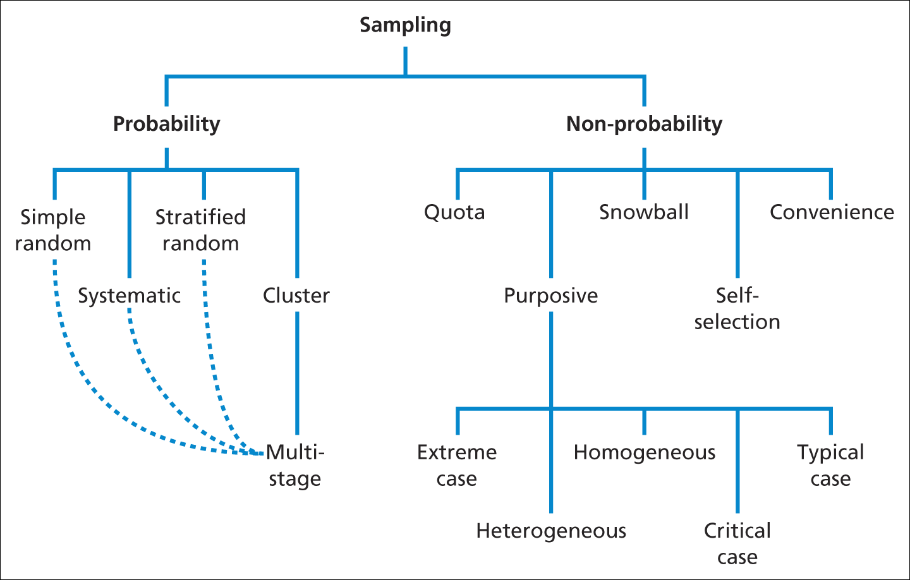
Overview of sampling techniques
Sampling techniques
Source: Saunders et al. (2009)
Figure 7.2 Sampling techniques

Slide 19
Probability and Non-Probability Sampling
Probability Sampling – Every element in the population under study has a non-zero probability of selection to a sample, and every member of the population has an equal probability of being selected
Non-Probability Sampling – An arbitrary means of selecting sampling units based on subjective considerations, such as personal judgment or convenience. It is less preferred to probability sampling

Slide 20
Non-Probability Sampling (1)
Convenience Sampling – This is a sampling technique which selects those sampling units most conveniently available at a certain point in, or over a period, of time
Major advantages of convenience sampling is that is quick, convenient and economical; a major disadvantage is that the sample may not be representative
Convenience sampling is best used for the purpose of exploratory research and supplemented subsequently with probability sampling

Slide 21
Non-Probability Sampling (2)
Judgment (purposive) Sampling – This is a sampling technique in which the business researcher selects the sample based on judgment about some appropriate characteristic of the sample members
Example 1: The Consumer Price Index (CPI) is based on a judgment sample of market-based items, housing costs, and other selected goods and services which are representative for most of the overall population in terms of their consumption
Example 2: Selection of certain voting districts which serve as indicators for the national voting trend

Slide 22
Purposive sampling
Extreme case/deviant sampling: unusual or special case enable to learn the most about the RQ.
Heterogeneous or maximum variation sampling: representing different subgroups
Homogeneous sampling: One subgroup.
Critical case sampling:
If it happen there, it will happen everywhere.

Slide 23
Non-Probability Sampling (3a)
Quota Sampling – This is a sampling technique in which the business researcher ensures that certain characteristics of a population are represented in the sample to an extent which is he or she desires
Example: A business researcher wants to determine through interview, the demand for Product X in a district which is very diverse in terms of its ethnic composition. If the sample size is to consist of 100 units, the number of individuals from each ethnic group interviewed should correspond to the group’s percentage composition of the total population of that district

Slide 24
Quota Sampling
Divide the population into specific groups.
Calculate quota for each group based on relevant and available data
Collect data from each quota

Slide 25
Non-Probability Sampling (3b)
Quota Sampling has advantages and disadvantages:
Advantages include the speed of data collection, less cost, the element of convenience, and representativeness (if the subgroups in the sample are selected properly)
Disadvantages include the element of subjectivity (convenience sampling rather than probability-based which leads to improper selection of sampling units)

Slide 26
Non-Probability Sampling (4)
Snowball Sampling – This is a sampling technique in which individuals or organizations are selected first, and then additional respondents are identified based on information provided by the first group of respondents
Example: Through a sample of 500 individuals, 20 scuba-diving enthusiasts are identified which, in turn, identify a number of other scuba-divers
The advantage of snowball sampling is that smaller sample sizes and costs are necessary; a major disadvantage is that the second group of respondents suggested by the first group may be very similar and not representative of the population with that characteristic

Slide 27
Snowball sampling
Make contact with one or two cases in the population.
Ask these cases to identify further cases.
Ask these new case to identify further new cases.
Stop when either no new cases are given or the sample is large enough.

Slide 28
Classification of Sampling Techniques
Fig. 11.2
Sampling Techniques
Nonprobability
Sampling Techniques
Probability
Sampling Techniques
Convenience
Sampling
Judgmental
Sampling
Quota
Sampling
Snowball
Sampling
Simple Random
Sampling
Systematic
Sampling
Stratified
Sampling
Cluster
Sampling
Other Sampling
Techniques

Slide 29
Probability Sampling (1)
Simple Random Sampling – This is a technique which ensures that each element in the population has an equal chance of being selected for the sample
Example: Choosing raffle tickets from a drum, computer-generated selections, random-digit telephone dialing
The major advantage of simple random sampling is its simplicity

Slide 30
Simple random sampling
Number each of the cases in your sampling frame with a unique number.
Select cases using random numbers until, actual sample size is reached.
Computer aided telephone interviewing (CATI) software

Slide 31
Simple Random
Advantages
Easy to implement with random dialing
Disadvantages
Requires list of population elements
Time consuming
Uses larger sample sizes
Produces larger errors
High cost

Slide 32
Probability Sampling (2)
Systematic Sampling – This is a technique which in which an initial starting point is selected by a random process, after which every nth number on the list is selected to constitute part of the sample
Example: From a list of 1500 name entries, a name on the list is randomly selected and then (say) every 25th name thereafter. The sampling interval in this case would equal 25.
For systematic sampling to work best, the list should be random in nature and not have some underlying systematic pattern

Slide 33
Systematic Random Sampling
Number each of the cases in your sampling frame with a unique number.
Select the first case using a random number
Calculate the sampling fraction
Select subsequent cases systematically using the sampling fraction to determine the frequency of selection.
Sampling fraction = actual sample size/ total population

Slide 34
Probability Sampling (3)
Stratified Sampling – This is a technique which in which simple random subsamples are drawn from within different strata that share some common characteristic
Example: The student body of NIT is divided into two groups (management science, engineering) and students are selected using simple random sampling from each group, whereby the size of the sample for each group is determined by that group’s overall strength
Stratified Sampling has the advantage of giving more representative samples and less random sampling error; the disadvantage lies therein, that it is more complex and information on the strata may be difficult to obtain

Slide 35
Stratified random sampling
Choose the stratification variable or variables
Divide the sampling frame into the discrete strata.
Number each of the cases within each stratum with a unique number
Select your sample using either simple random or systematic random sampling

Slide 36
Probability Sampling (4)
Cluster Sampling
Choose the cluster grouping for your sampling frame.
Number each of the clusters with a unique number.
Select sample of clusters using random sampling

Slide 37
Types of Cluster Sampling
Cluster Sampling
One-Stage
Sampling
Two-Stage
Sampling
Multistage
Sampling
Simple Cluster
Sampling
Probability
Proportionate
to Size Sampling

Slide 38
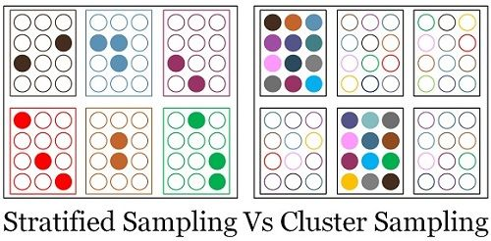

Slide 39
Stratified and Cluster Sampling
Stratified
Population divided into few subgroups
Homogeneity within subgroups
Heterogeneity between subgroups
Choice of elements from within each subgroup
Cluster
Population divided into many subgroups
Heterogeneity within subgroups
Homogeneity between subgroups
Random choice of subgroups
Notes:
Exhibit 14-7

Slide 40
Issues in Sample Design and Selection (1)
Accuracy – Samples should be representative of the target population (less accuracy is required for exploratory research than for conclusive research projects)
Resources – Time, money and individual or institutional capacity are very important considerations due to the limitation on them. Often, these resources must be “traded” against accuracy

Slide 41
Issues in Sample Design and Selection (2)
Availability of Information – Often information on potential sample participants in the form of lists, directories etc. is unavailable (especially in developing countries) which makes some sampling techniques (e.g. systematic sampling) impossible to undertake
Geographical Considerations – The number and dispersion of population elements may determine the sampling technique used (e.g. cluster sampling)
Statistical Analysis – This should be performed only on samples which have been created through probability sampling (i.e. not probability sampling)

Slide 42
Sample size
Choice of sample size is influenced by
Confidence needed in the data
Margin of error that can be tolerated
Margin of error (also called The confidence interval ) is the plus-or-minus figure usually reported in newspaper or television opinion poll results. For example, if you use a margin of error of 4 and 47% percent of your sample picks an answer you can be "sure" that if you had asked the question of the entire relevant population between 43% (47-4) and 51% (47+4) would have picked that answer.
Types of analyses to be undertaken
Size of the sample population and distribution

Slide 43
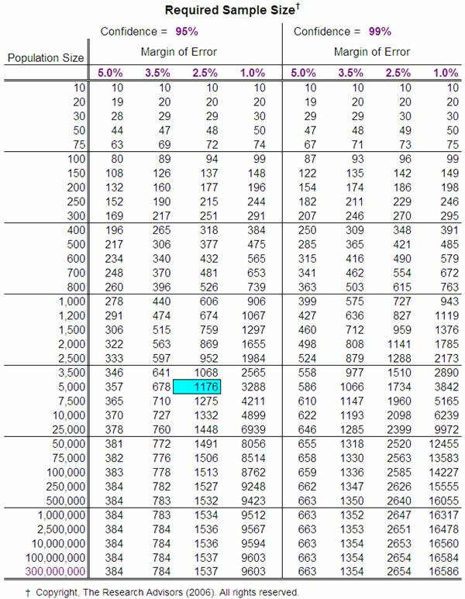

Slide 44
The importance of response rate
Key considerations
Non- respondents and analysis of refusals
Obtaining a representative sample
Calculating the active response rate
Estimating response rate and sample size

Slide 45
Assignment 1 Results
Proposal Titles | Score
Judgment and Beliefs of Society: Curse for Women’s | 8.25
FLOODS IN ODISHA | 6.75
Unaffordable Housing in Rourkela | 6.5
How the Teacher-Student Ratio affects quality of Education in NITR | 6
The Tribal India: Life vs Lifestyle | 6
Excessive Consumption of Drugs by Youth | 5.5
Report On Increasing Youth Suicide | 5.5
Indigenous Tribes and the new challenge of Globalization | 5.5
Human’s being Inhumane on Non-Human’s | 4.5
Pollution effect of Industries in Visakhapatnam | 4.5
Report On Sexual Harrassment at Workplace | 4.5
INCREASING YOUTH SUICIDES IN INDIA | 4
Mental Health Among the Students | 4

